Slide 1
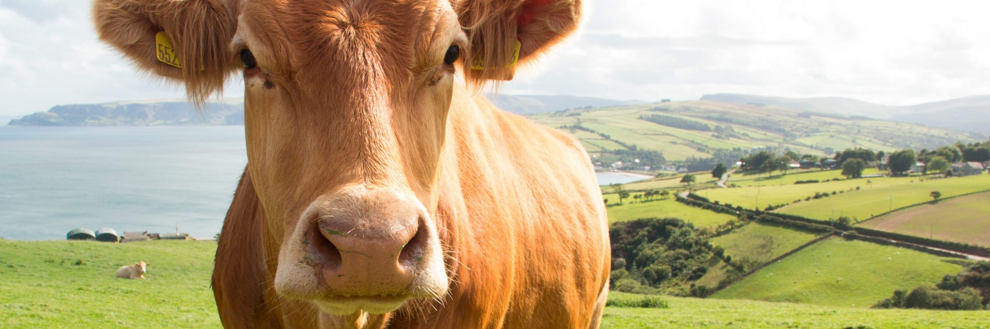

Compression algorithms to optimize battery
consumption in precision livestock farming

Slide 2

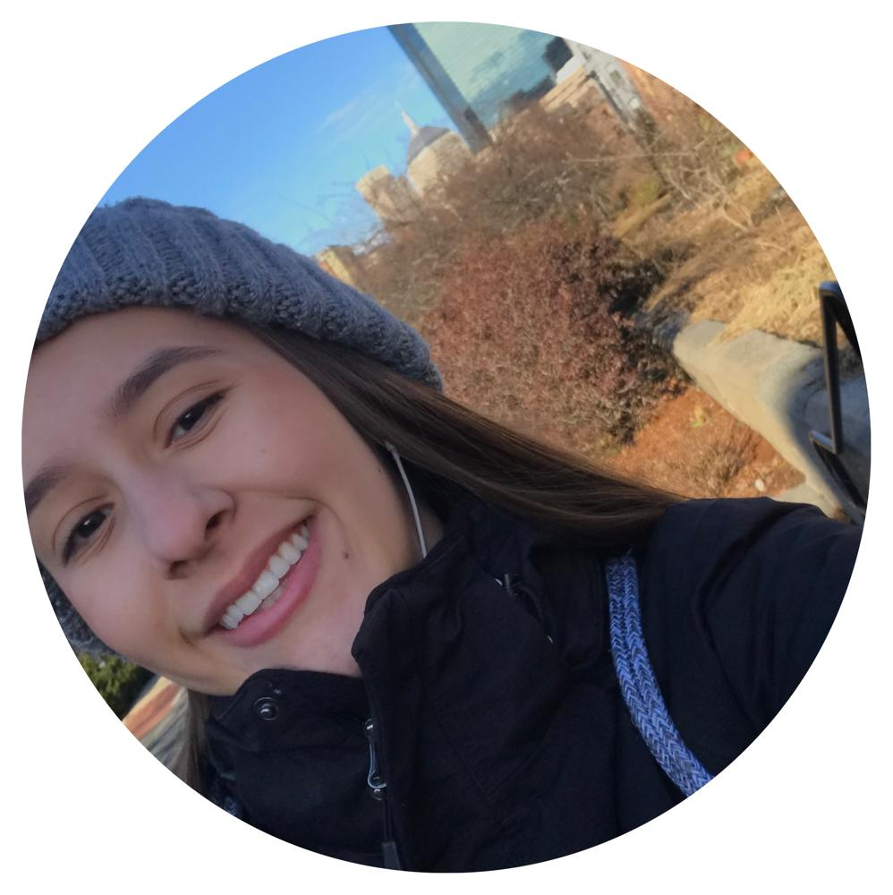

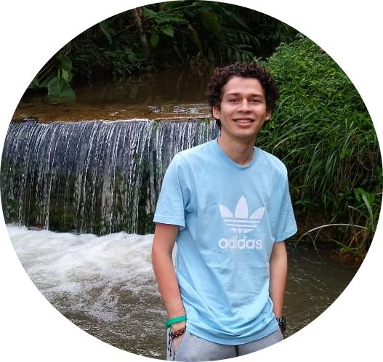
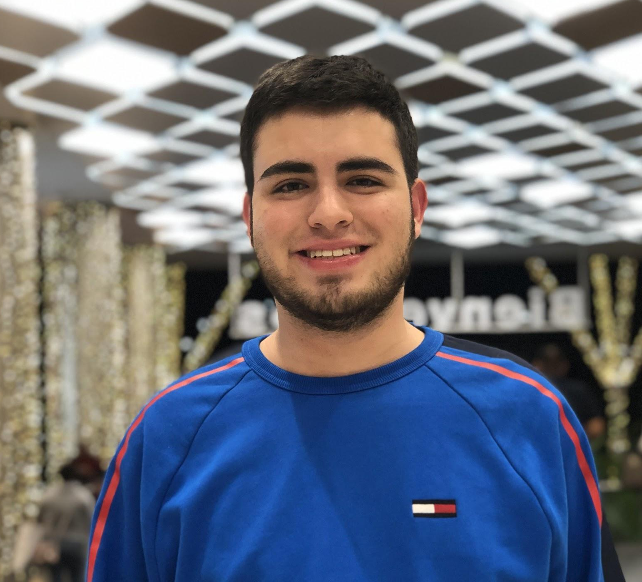
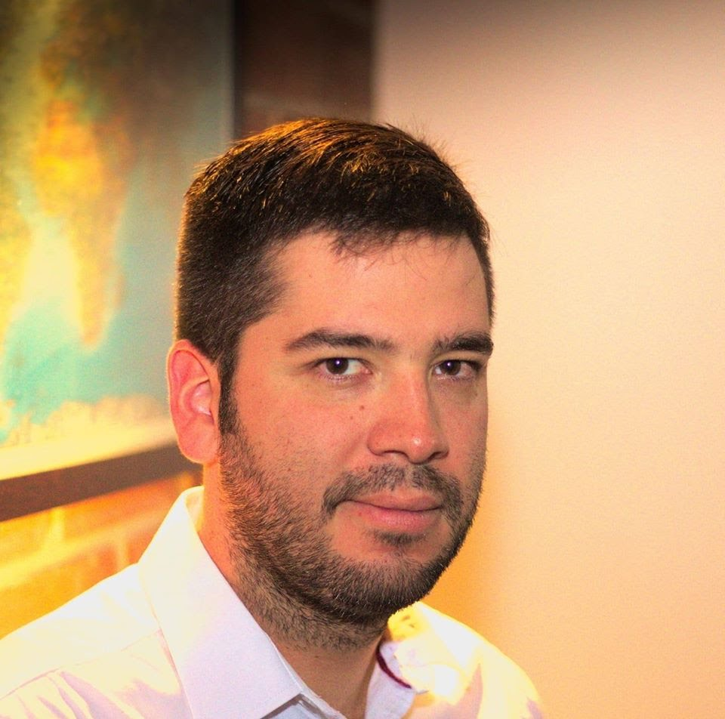

Team Presentation
Maria Isabel Arango
Isabella Montoya
Andrés
Agudelo
Simón Marín
Mauricio
Toro
https://github.com/imontoyah/ST0245-002/tree/master/proyecto

Slide 3
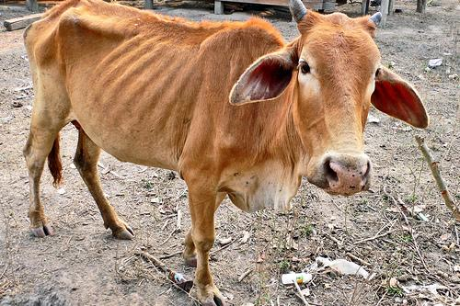
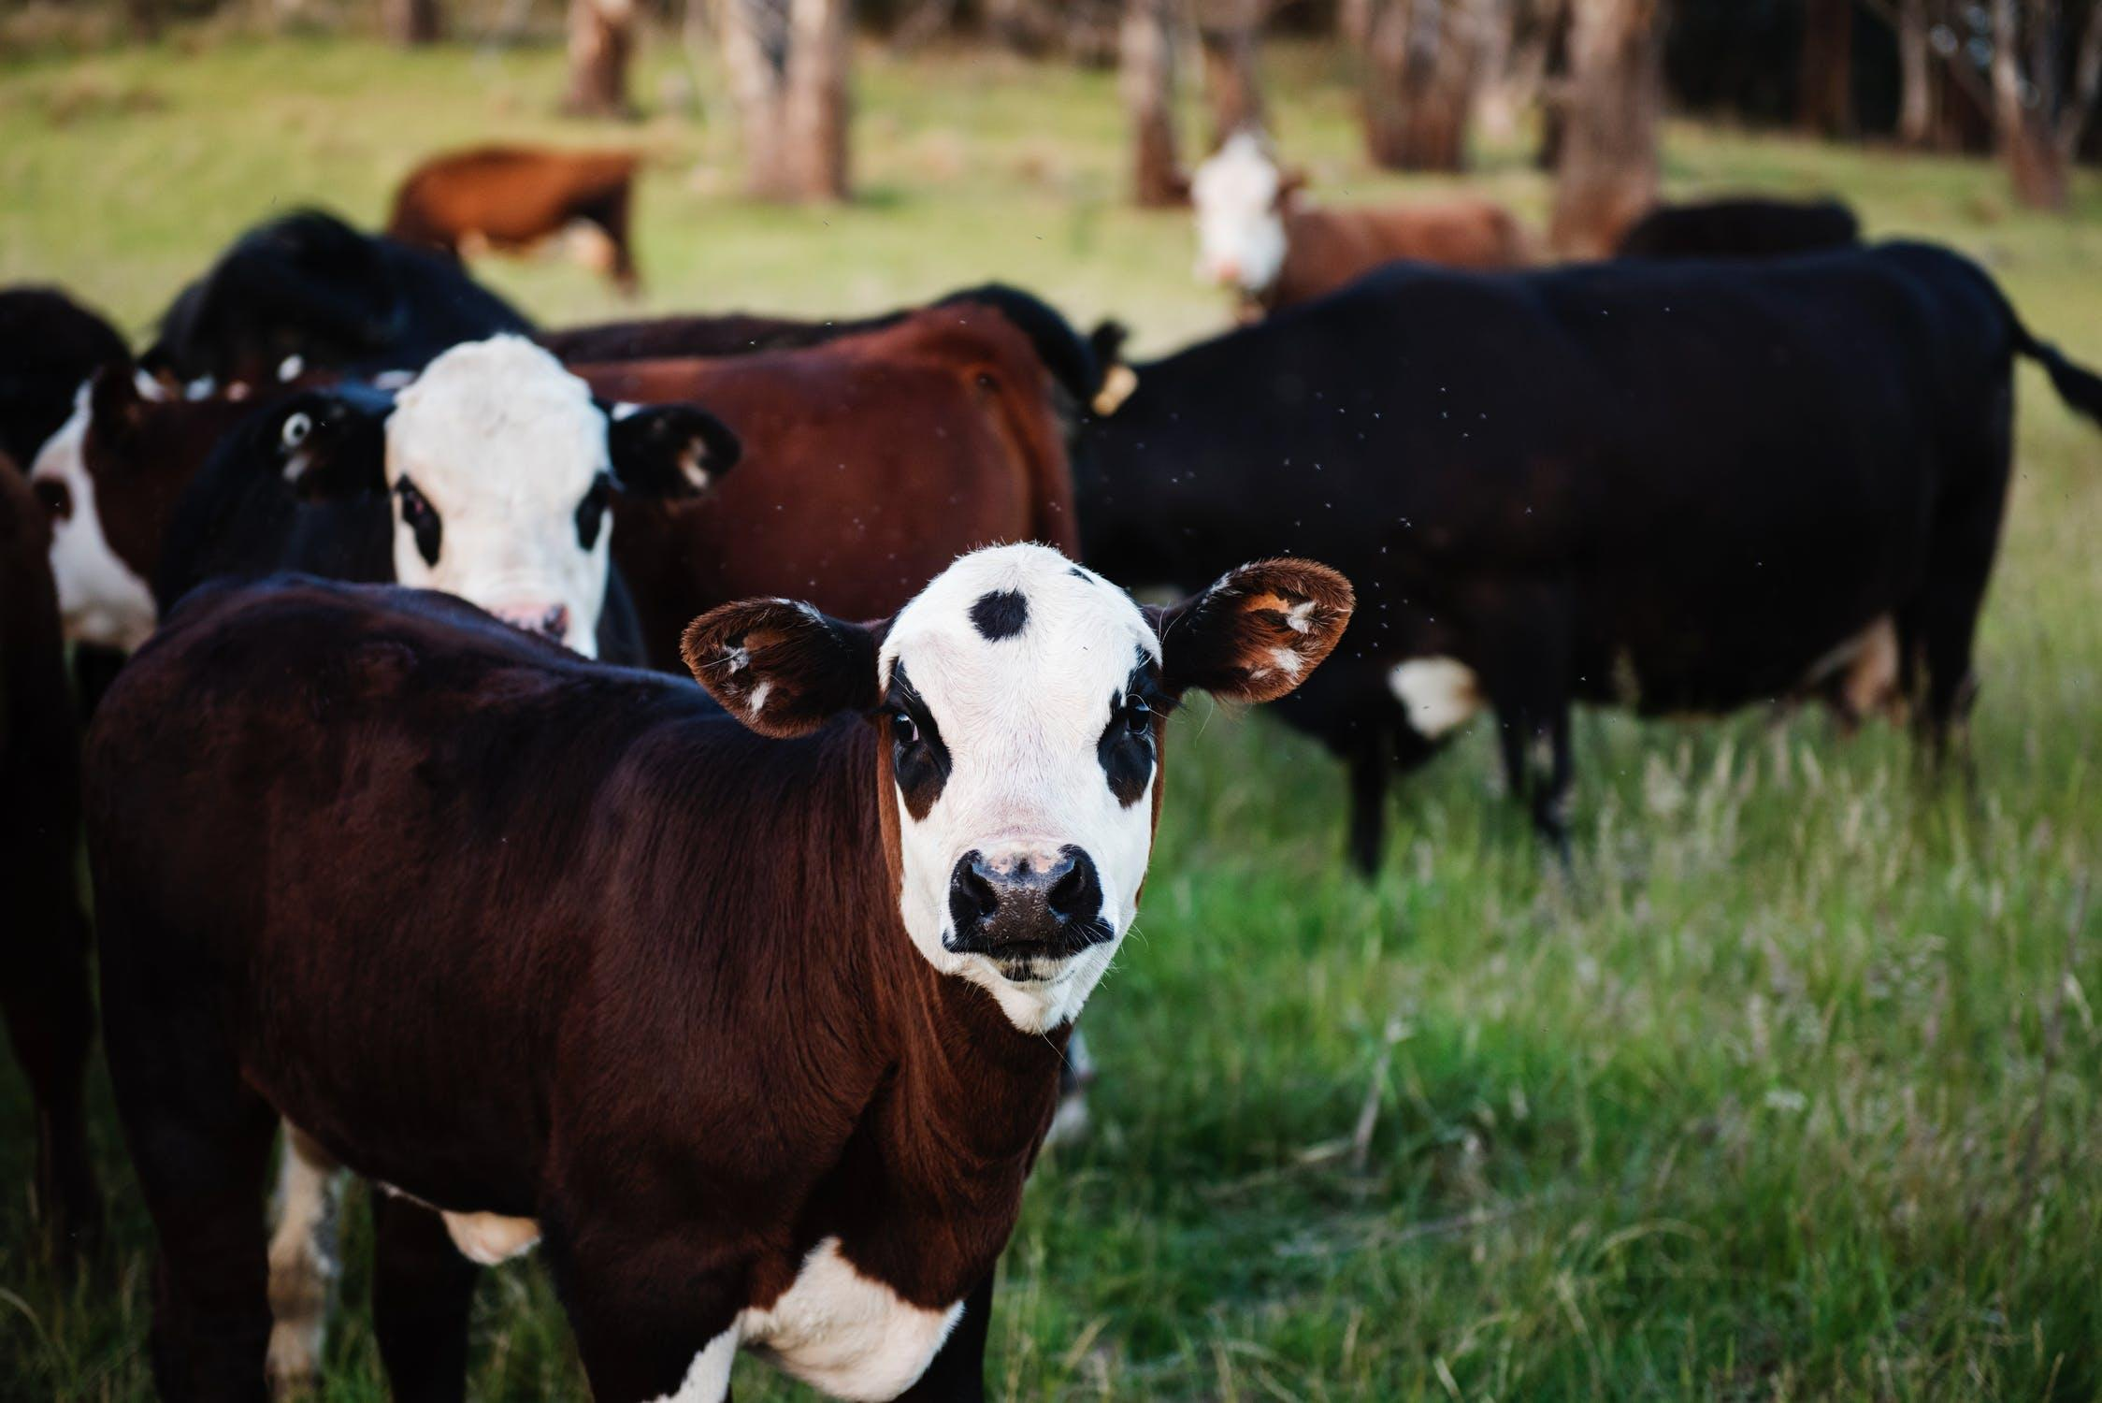
Training Process
Convolutional Neural Network
Sick-Cattle Images
Classification Algorithm
Classification Model
Healthy-Cattle Images

Slide 4
THANK YOU!.

